Slide 1
Orientation Class
Backend Development using Python

Slide 2
Computer Basics

Slide 3
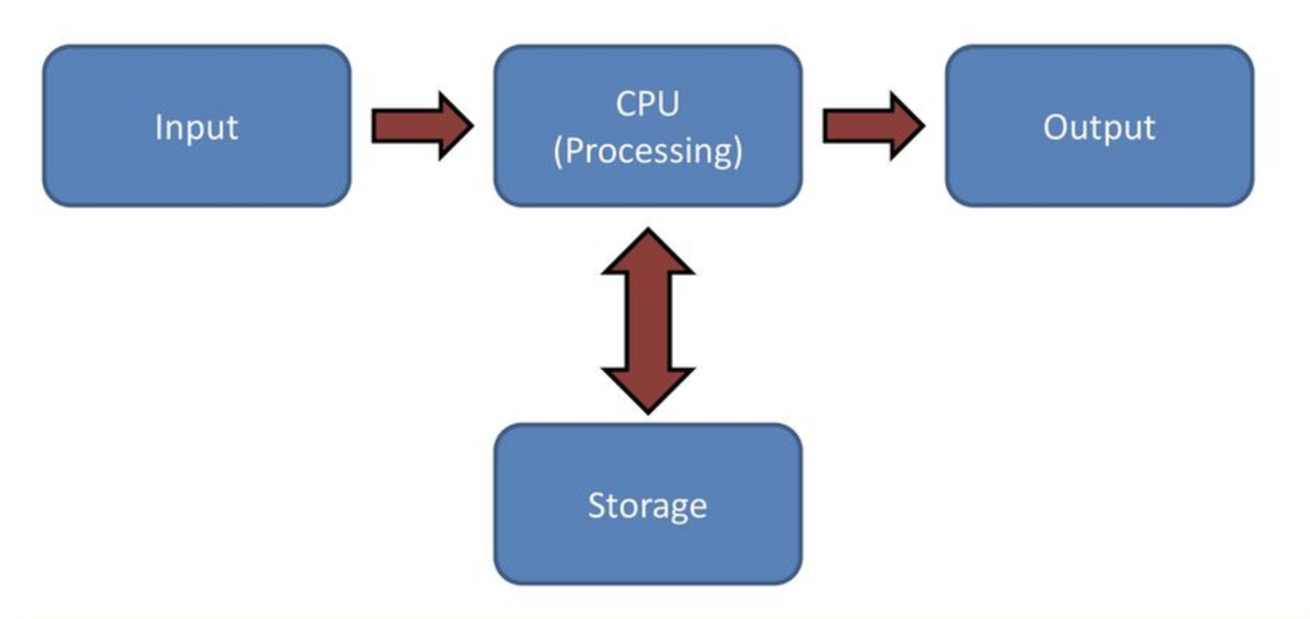
What is Computer
Definition: An electronic device for storing and processing data, typically in binary form, according to instructions given to it in a variable program.
Examples:
Analog Computer (physical property: voltage, temperature, pressure, speed etc)
Digital Computer
Hybrid Computer
Computer Basics

Slide 4
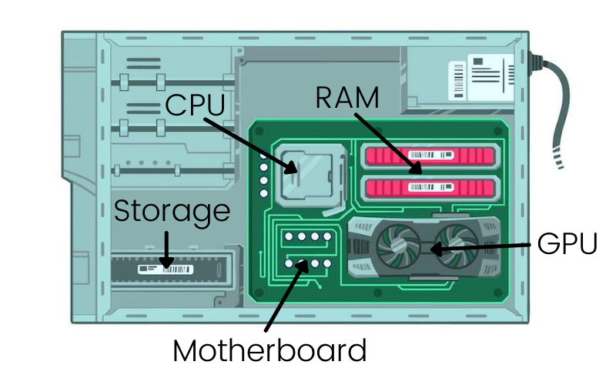
Hardware
Definition: Physical component of a computer system.
Mother Board
CPU
Storage
RAM
HDD/SDD
GPU
Power Supply
More Reading: What is inside CPU
Computer Basics

Slide 5
Software
Definition: Software is a set of instructions, data or programs used to operate computers and execute specific tasks.
Example:
Application Software
System Software
Driver Software
Computer Basics

Slide 6
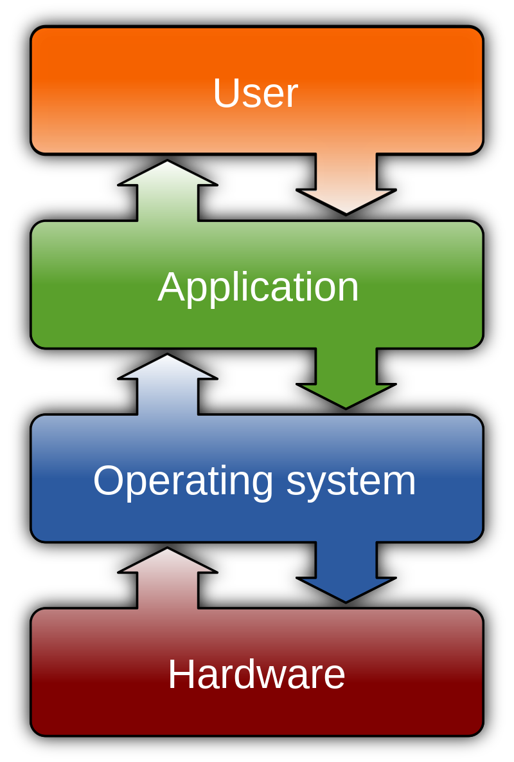
How Software and Hardware Interacts
Computer Basics

Slide 7
What is Programming
Examples of Programming Languages
Definition: the process of writing code to facilitate specific actions in a computer, application or software program, and instructs them on how to perform.
Python
Javascript
PHP
Ruby on Rails
C++
C#
Java
Kotlin
Golang
Rust
Dart

Slide 8
Career Domains in IT for Programmers
Web App Development (FE/BE/FullStack)
Mobile App
Desktop App
Mobile Cross Platform
Data Science
Blockchain
Game
DevOps
Automation
JS, Python, PHP, C# etc
Java, Kotlin, C++, C#
C#, Java, C++
JS, Dart, C#
Python, R, Vyper
Solidity, Rust etc
C++, C#, Java etc
Scripts
Python, JS, C#, C++ etc

Slide 9
Difference Between FE and BE in Terms of Complexity
Frontend
Designing Creativity
Client Satisfaction
State Management
Graph
Multiple Layout
Backend
API Performance
API Versioning
Logs Management
Third Party Data Integration
DB Design
Multi Tenancy
Deployment
Availability
Scalability
Multiple Programming Languages

Slide 10
Introduction to Python
Released on February 20, 1991
Easy to Learn
Open Source
Portable
High Level Programming Language
Object Oriented
Interpreted Language
Dynamically Typed (vs Statically Typed)
Case Sensitive
Current Major Version of Python is 3

Slide 11
Why Python [1] - Usage
AI and machine learning
Data analytics
Data visualisation
Desktop applications
Web development
Game development for beginners

Slide 12
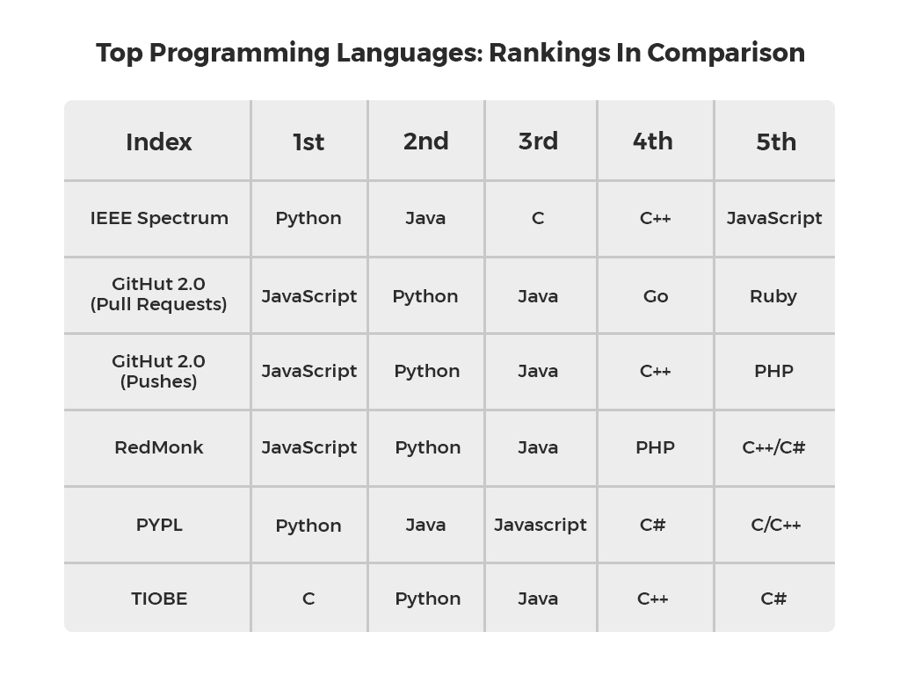
Why Python [2] - Popularity
https://brainstation.io/career-guides/who-uses-python-today
https://distantjob.com/blog/programming-languages-rank/

Slide 13
Python Jobs

Slide 14
Let's Get Connected Online
Google Classroom
Create (a professional) google account
Join classroom
Checkout Classroom Tab
Checkout Stream Tab
For new announcement
Ask for help
Whatsapp group (for quick notifications and answer only)
Create a group in Whatsapp
Join whatsapp group

Slide 15
What is Git

